Slide 1
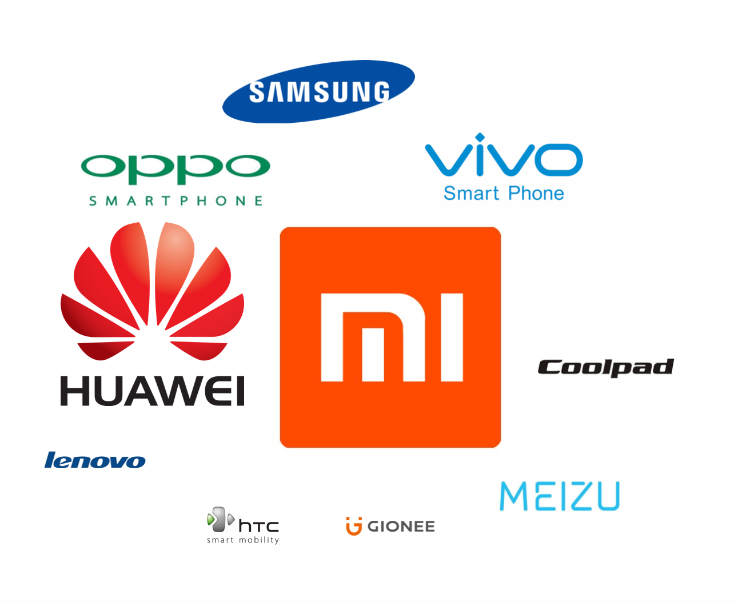
What are the most popular phone and APPs in China?
shuo zhang
07/31/2016

Slide 2
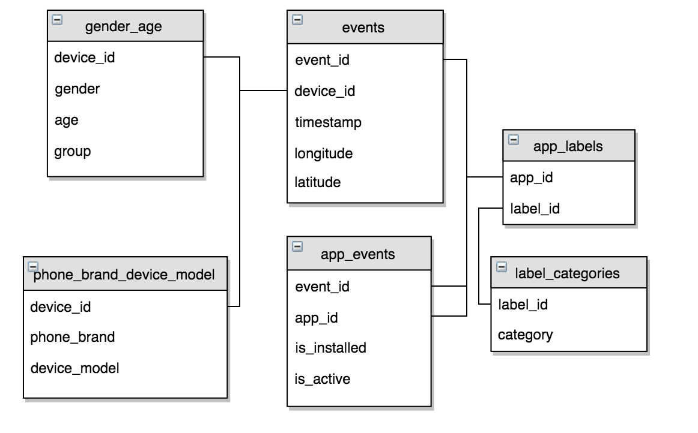
Data Description
The data set is provided by TalkingData, China’s largest third-party mobile data platform.
The data is from 05/01/2016 to 05/07/2016 and iphone data is excluded.
After data merge, two data sets are analyzed in the shiny.

Slide 3
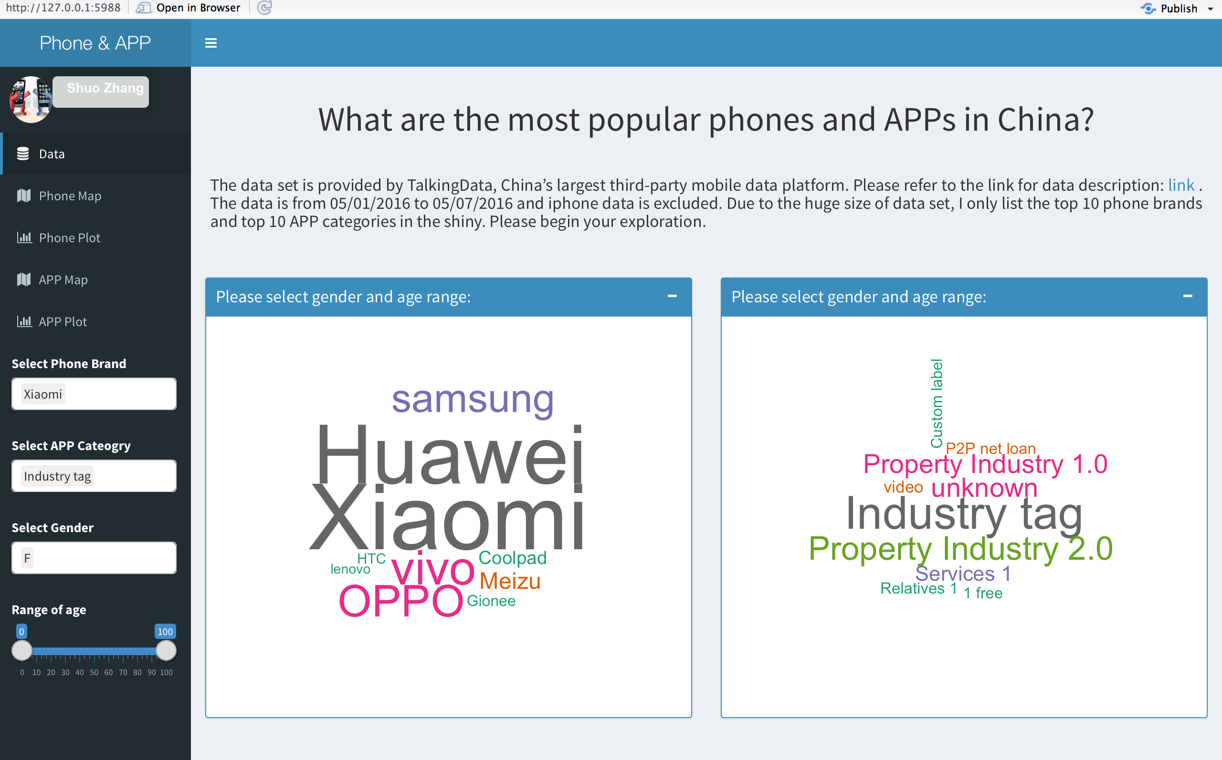
Data

Slide 4
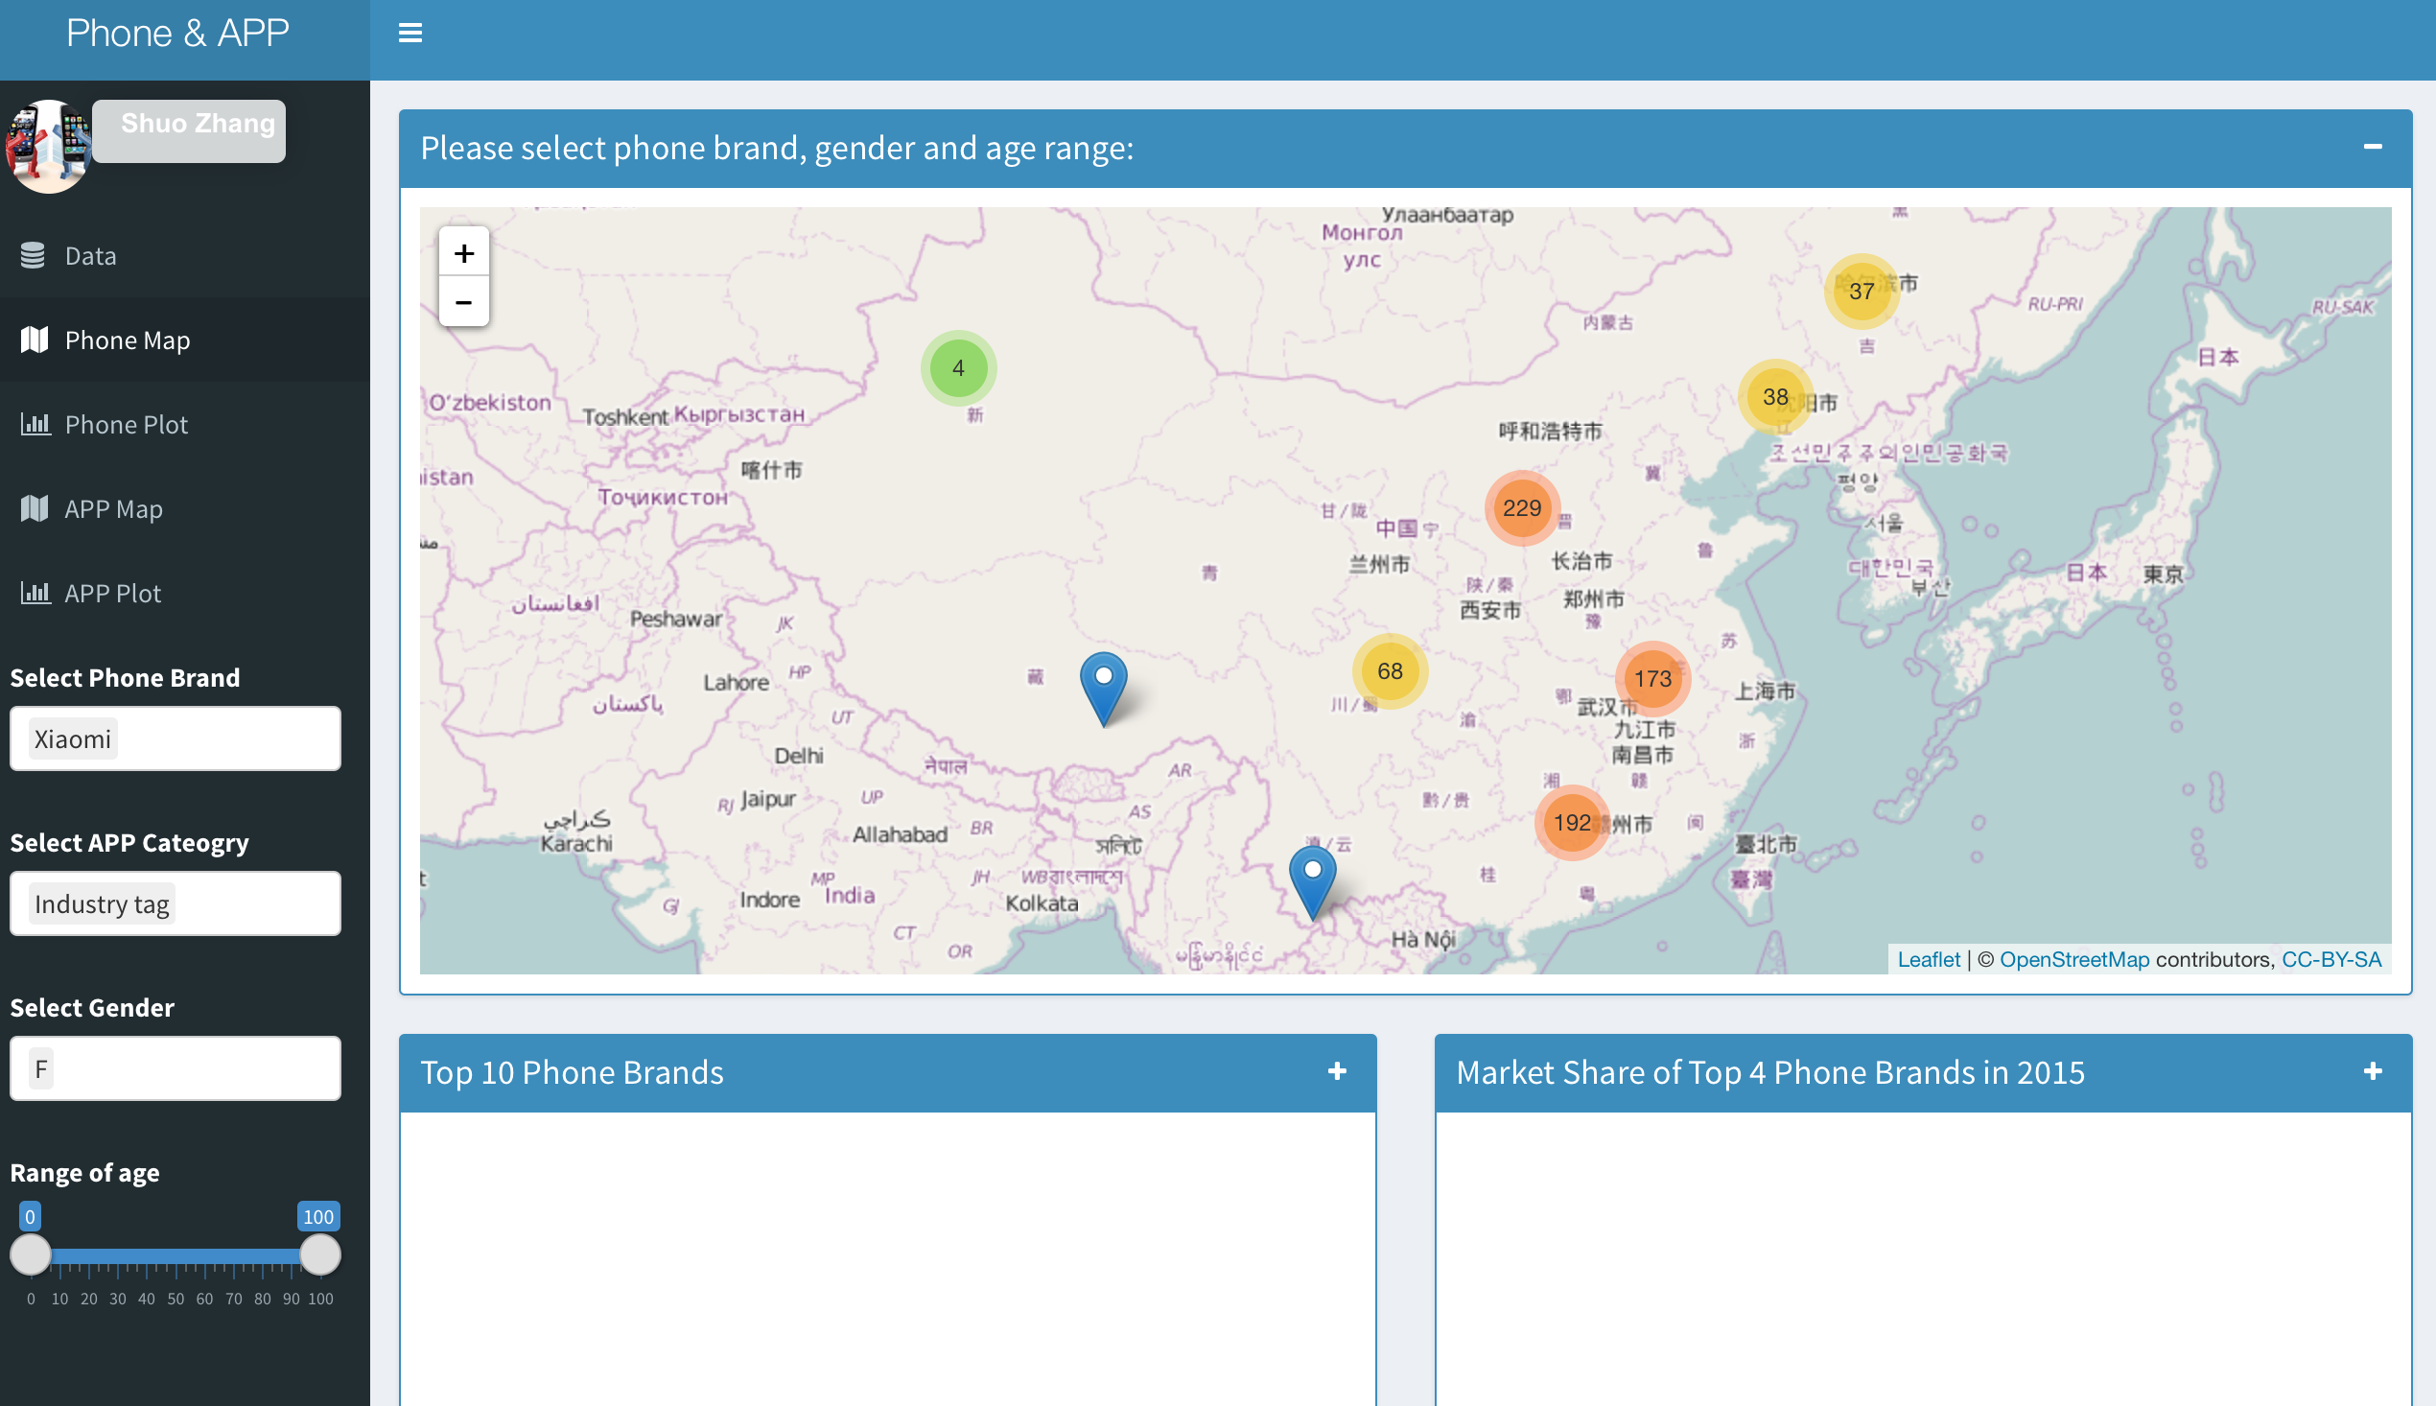
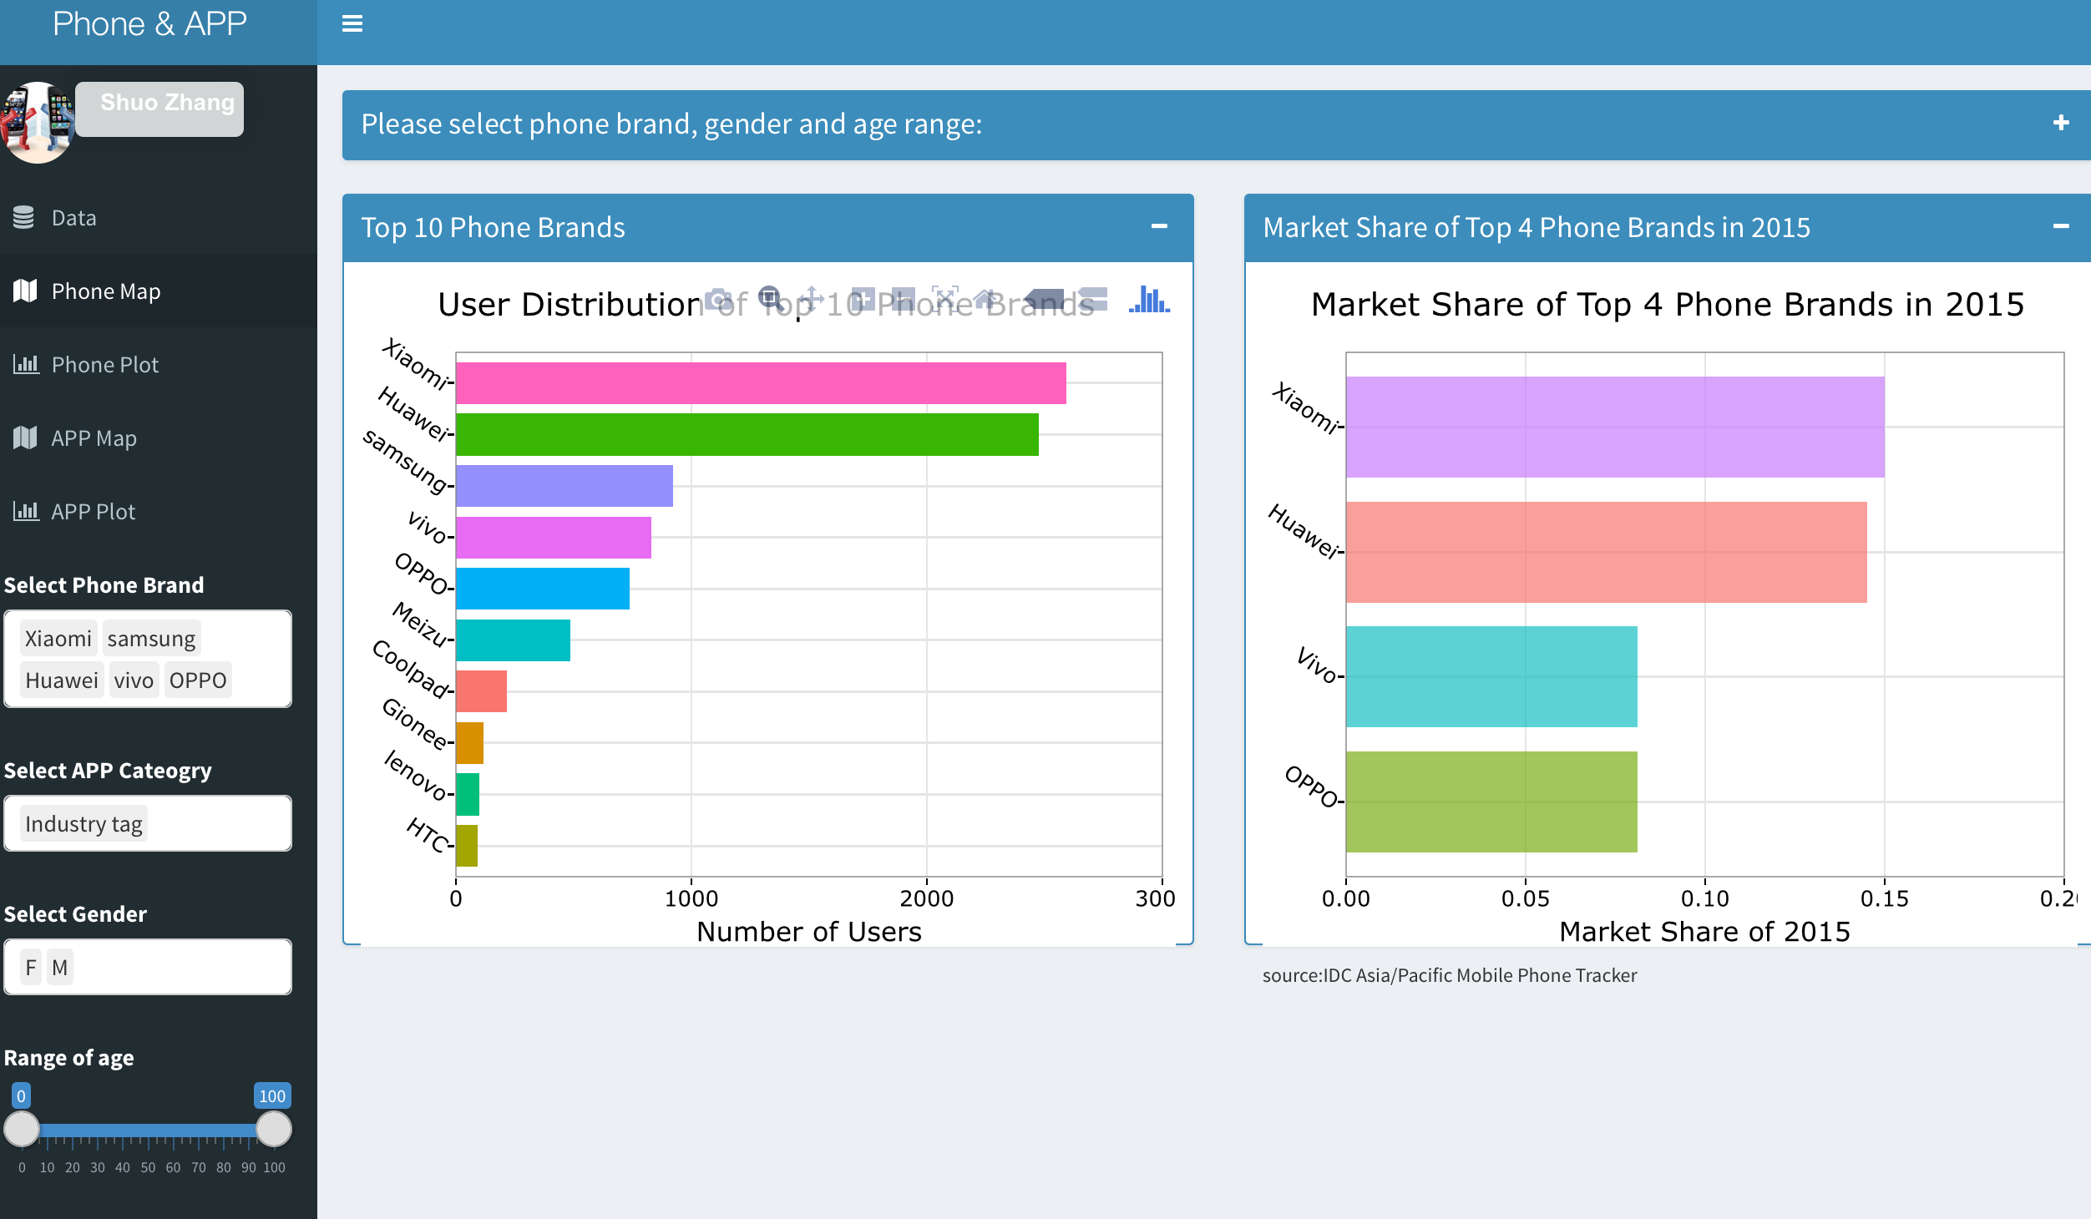
Phone Map

Slide 5
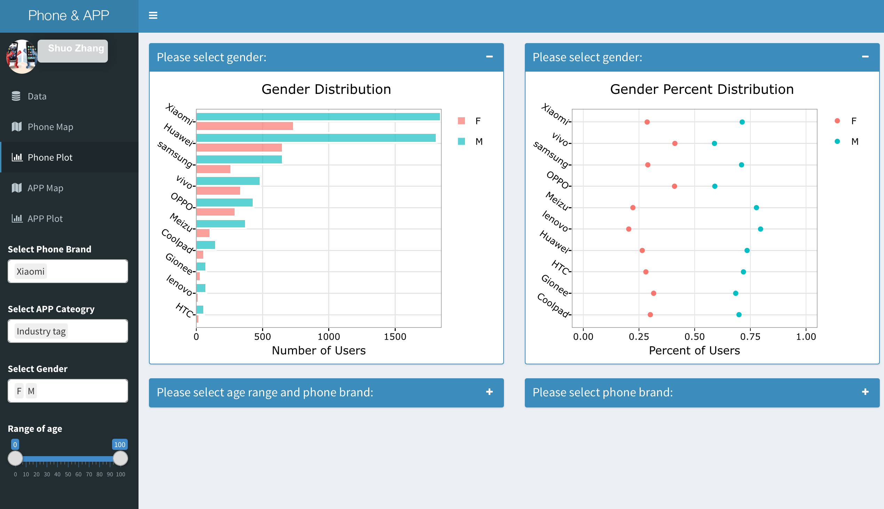
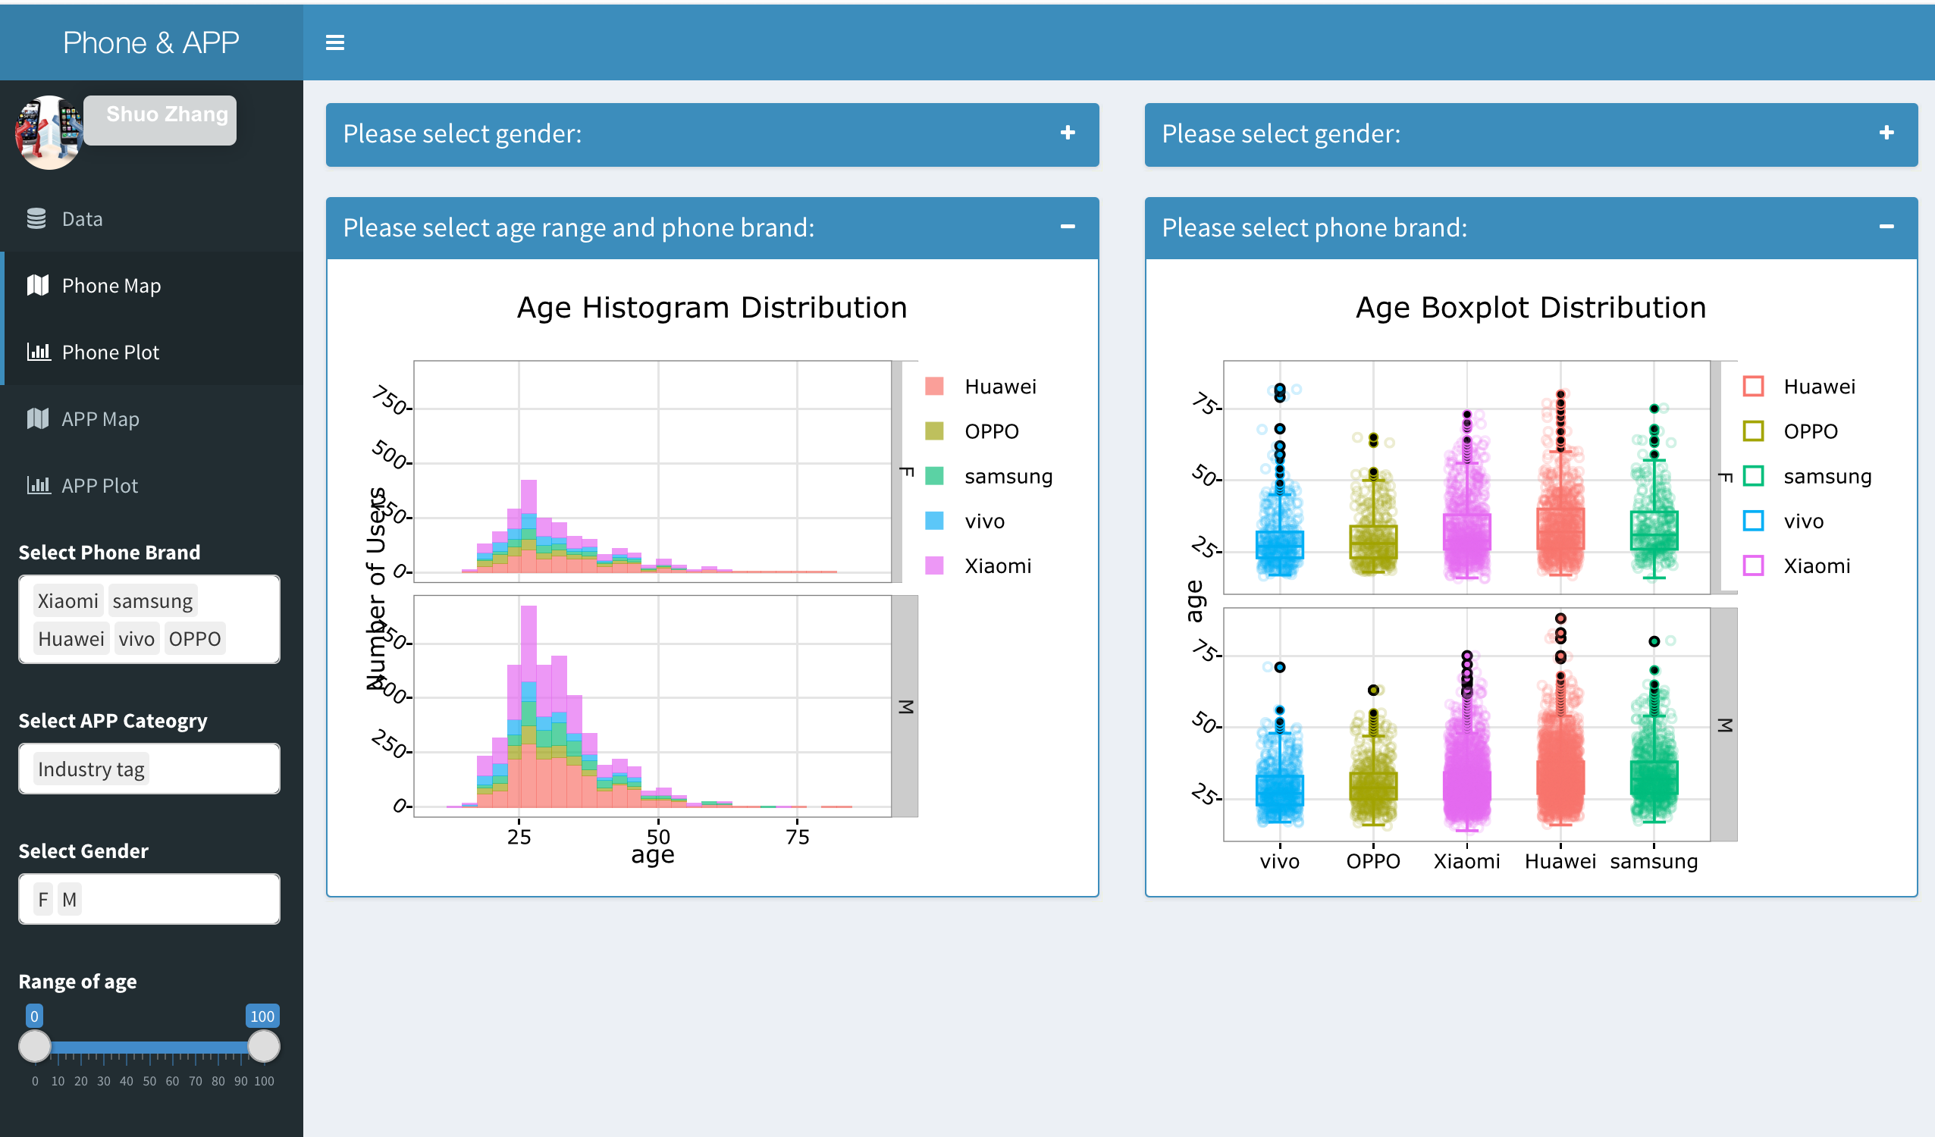
Phone Plot

Slide 6
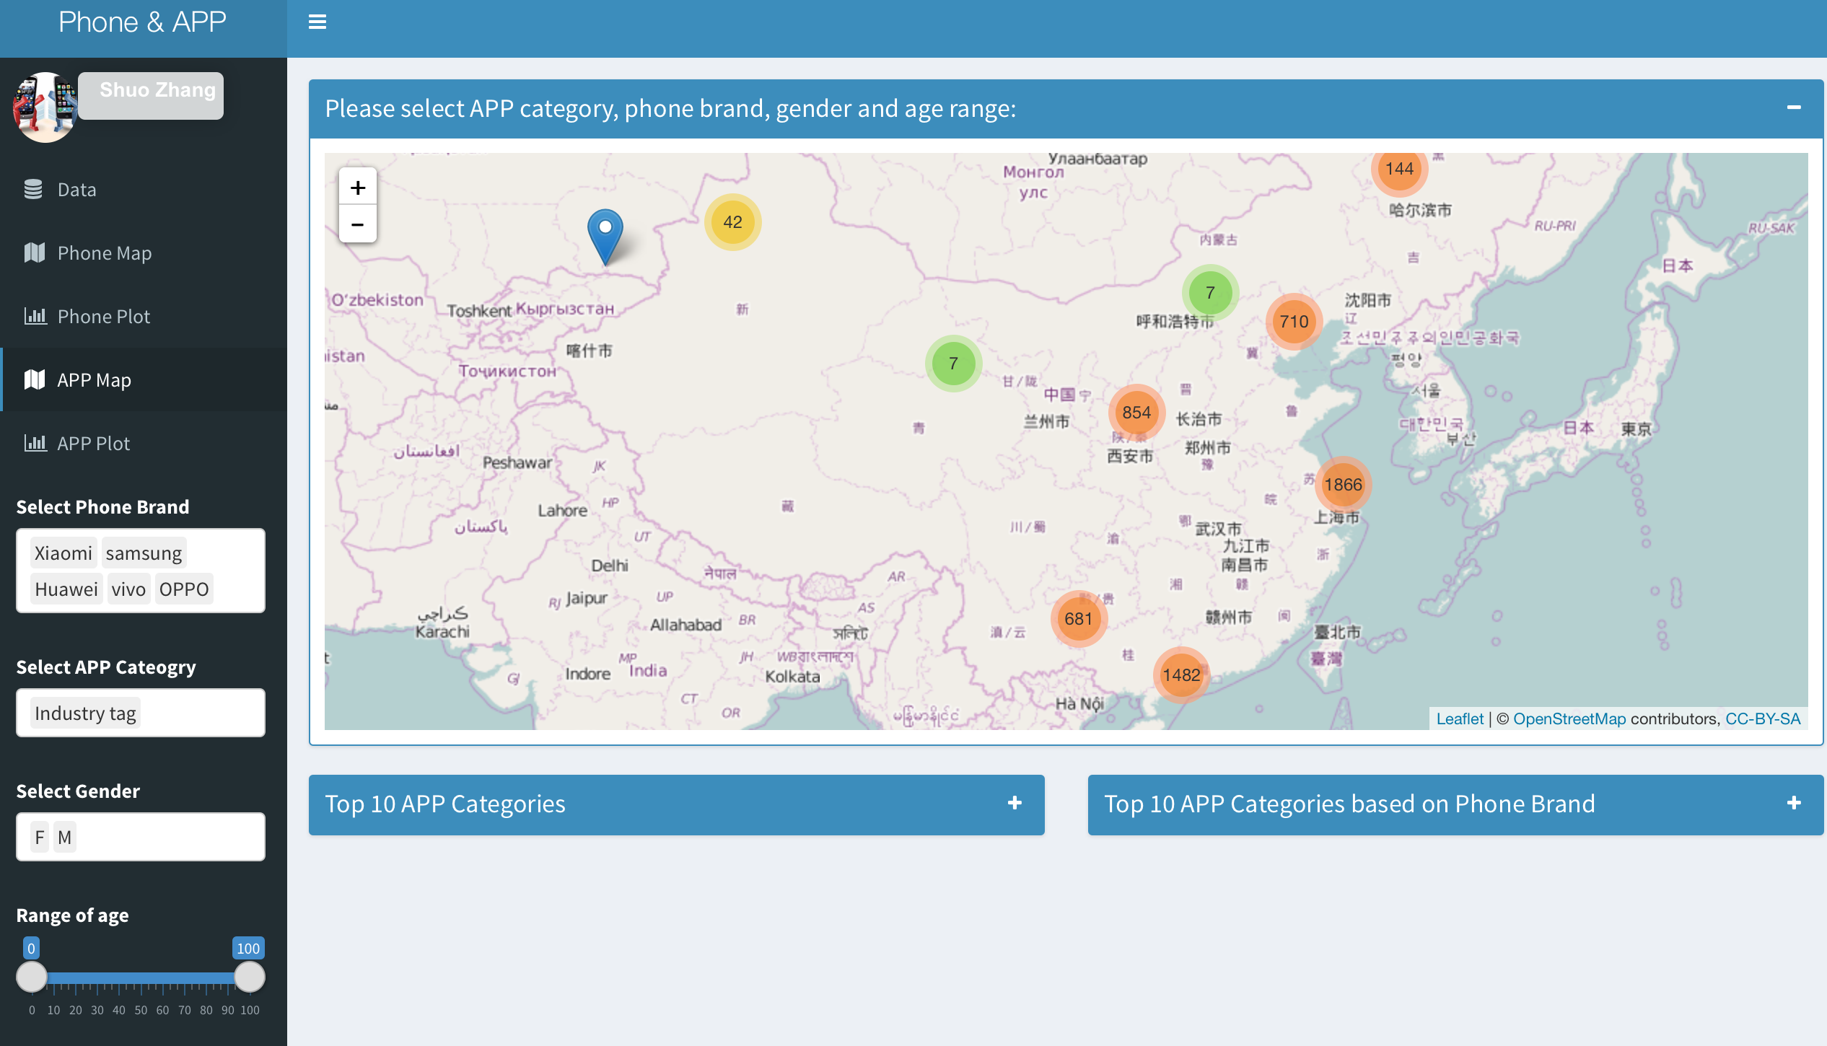
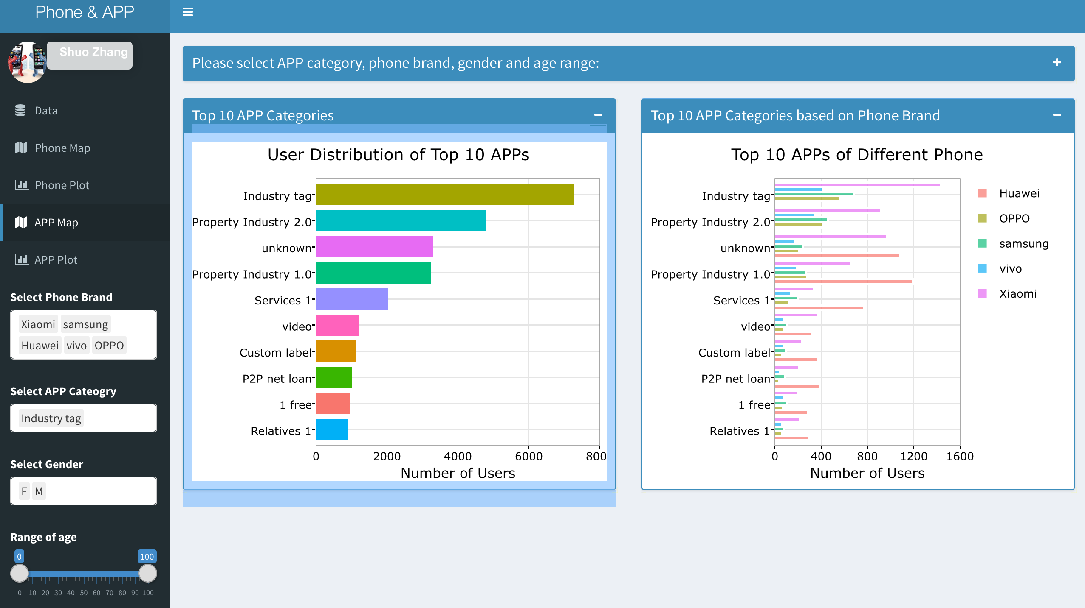
APP Map

Slide 7
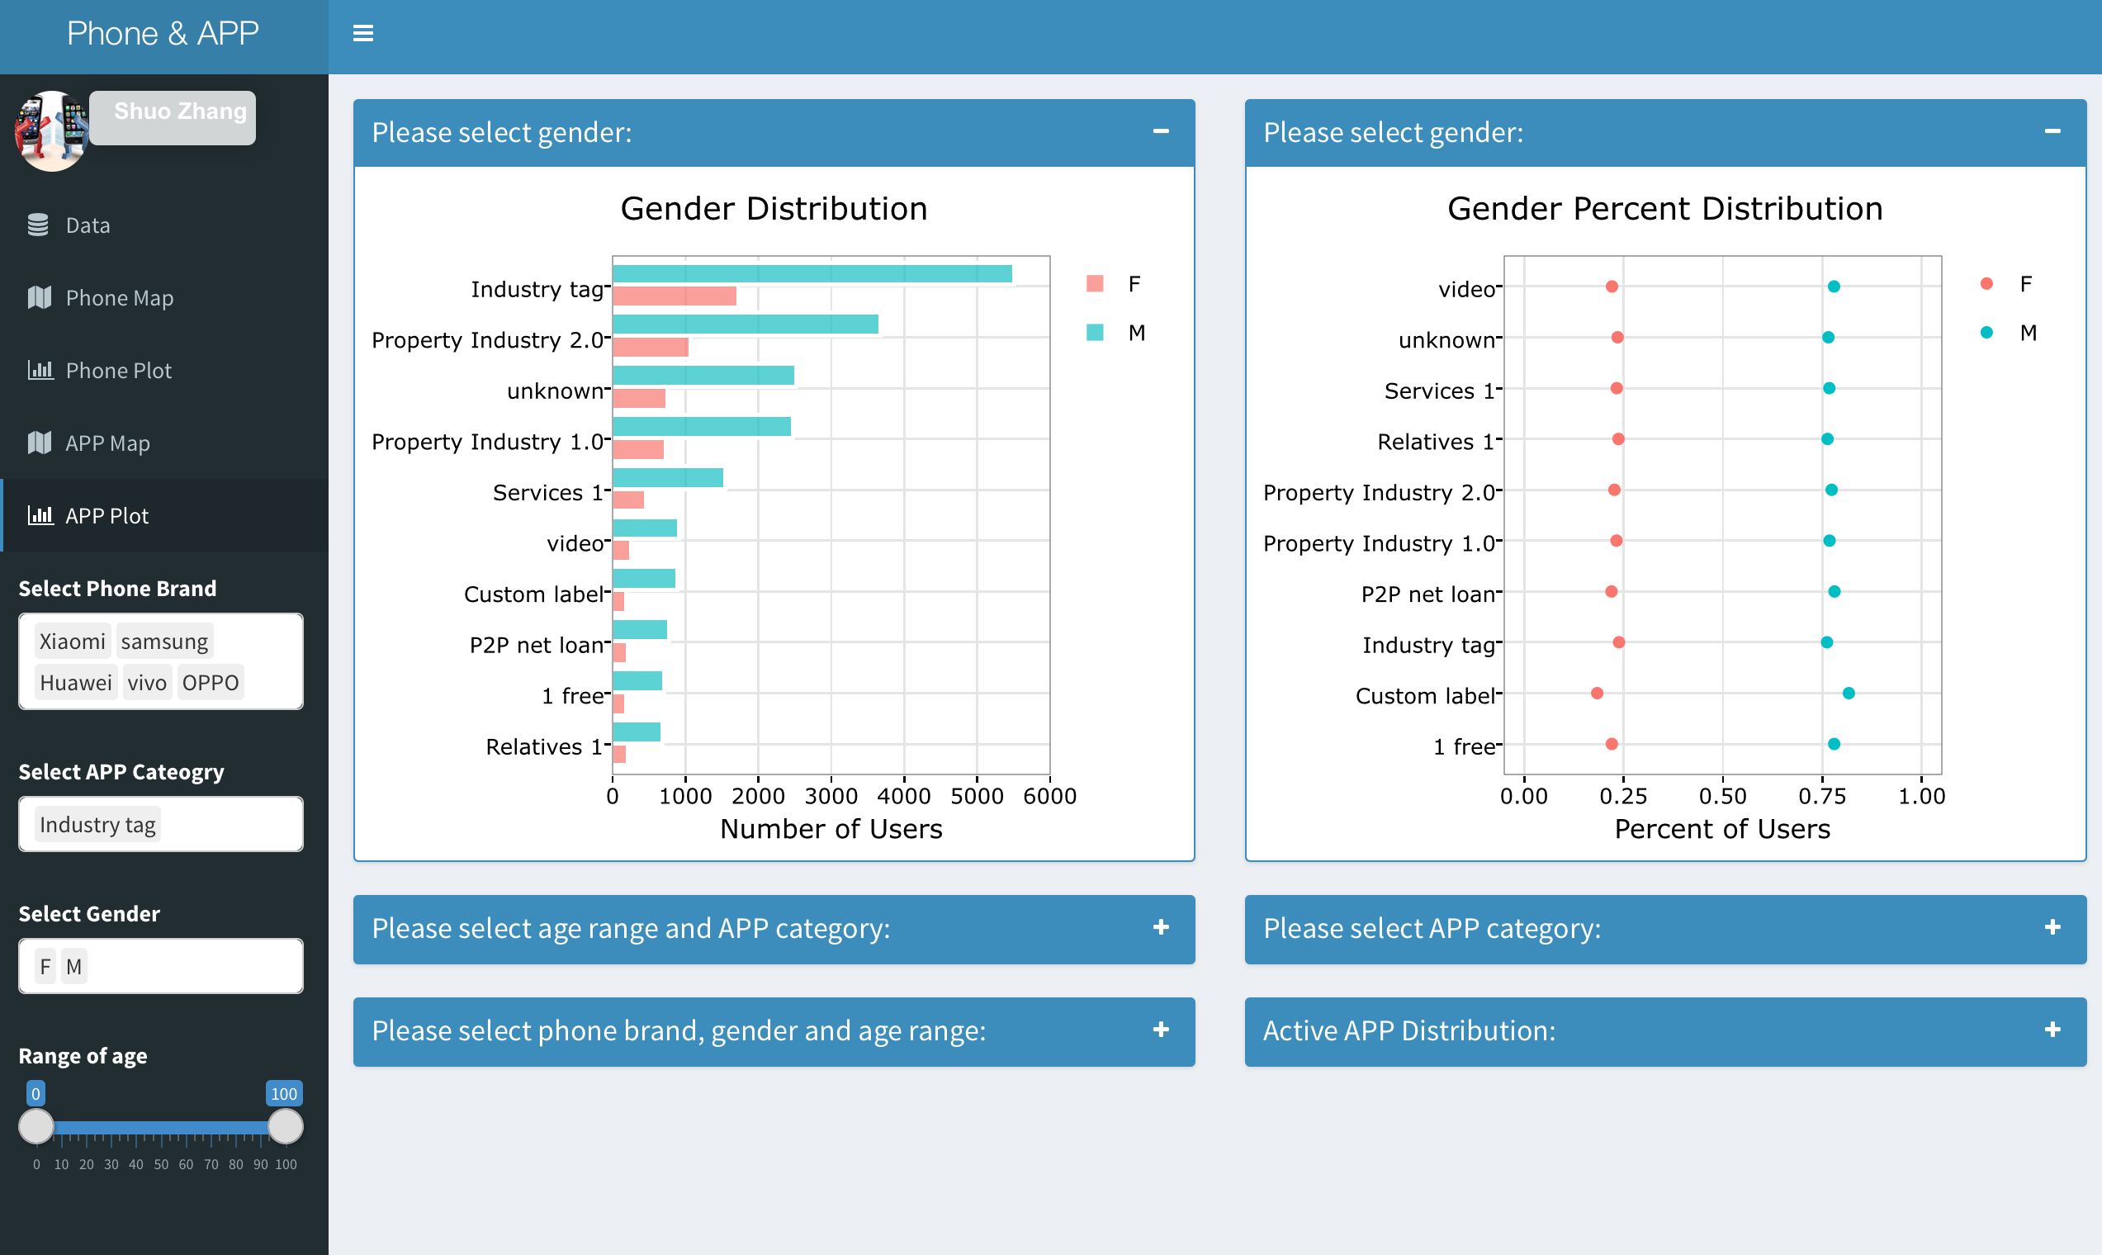
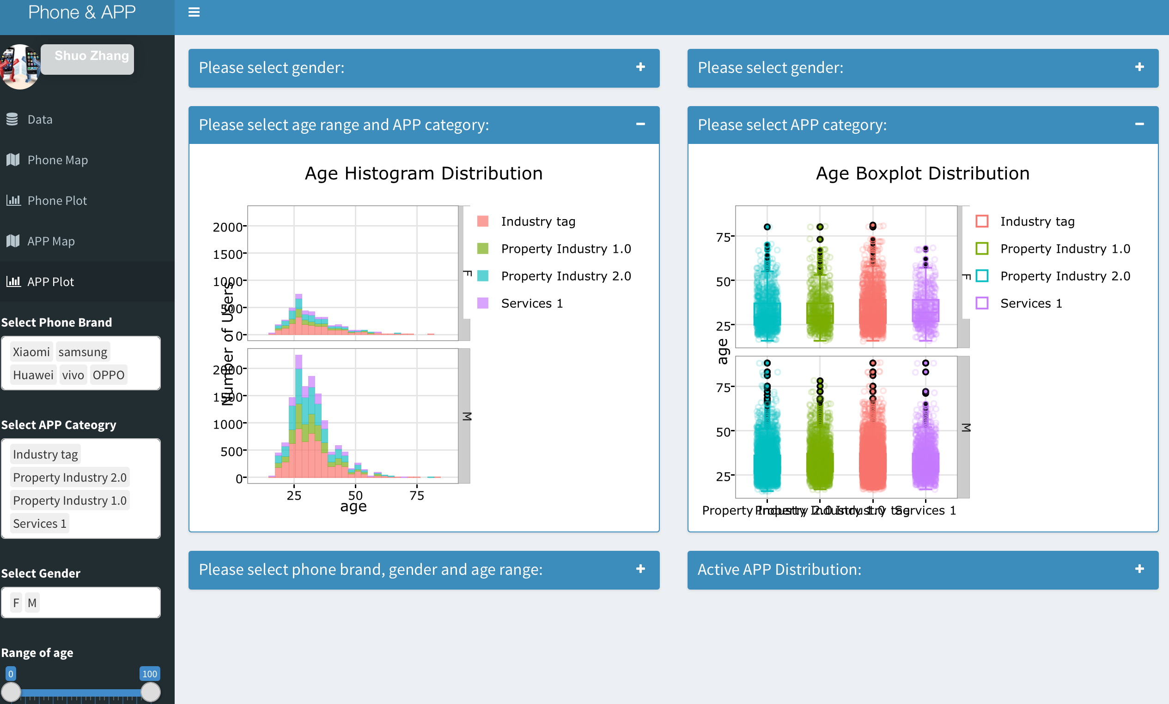
APP Plot

Slide 8
Discovery
Geographical, Gender and Age distribution of phone:
Top 3 cities: Beijing, Shanghai, Shenzhen
More male users than female users.
Compare Samsung Vivo and OPPO, female prefer fashion Vivo and OPPO and male prefer Samsung.
Different phone has different average user age.
Young generation prefer the fashion (and more affordable) OPPO and Vivo, while senior people prefer Huawei and Samsung . Xiaomi is the dominant.
Geographical, Gender and Age distribution of APP:
Top 3 cities: Beijing, Shanghai, Shenzhen
More male users than female users.
More inactive than active.
Different APP has different average user age.
Young and senior generation have same taste of APP preference.
Phone distribution is different dependent on phone.

